Slide 1
Hotel Reservation Analysis
Mentorness | Internship | SQL

Slide 2
Overview:
The Hotel industry depends on data to provide the best customer experience. In this project, I’ve worked with the hotel dataset to gain insights about data based upon the requirements so that management can decide what can be done to make a good customer experience.
I’ve used SQL in MySQL Workbench to compile and write queries.

Slide 3
Dataset Details
The dataset includes the following columns:
Booking_ID: A unique identifier for each hotel reservation.
no_of_adults: The number of adults in the reservation.
no_of_children: The number of children in the reservation.
no_of_weekend_nights: The number of nights in the reservation that fall on weekends.
no_of_week_nights: The number of nights in the reservation that fall on weekdays.
type_of_meal_plan: The meal plan chosen by the guests.
room_type_reserved: The type of room reserved by the guests.
lead_time: The number of days between booking and arrival.
arrival_date: The date of arrival.
market_segment_type: The market segment to which the reservation belongs.
avg_price_per_room: The average price per room in the reservation.
booking_status: The status of the booking.

Slide 4
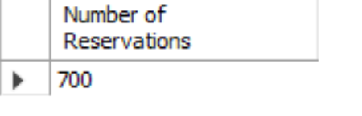
Problem Statement 1:
What is the total number of reservations in the dataset?
SQL Query:
Query Result:

Slide 5
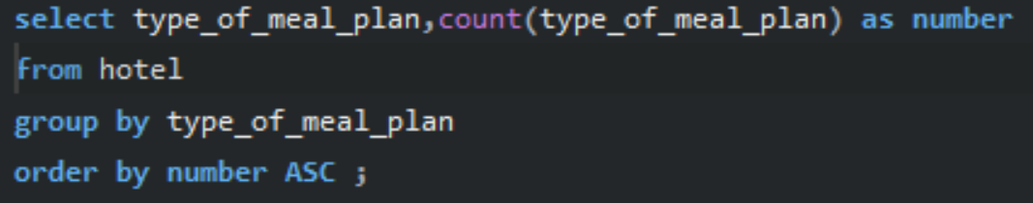
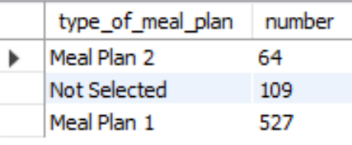
Problem Statement 2:
Which meal plan is the most popular among guests?
SQL Query:
Query Result:

Slide 6
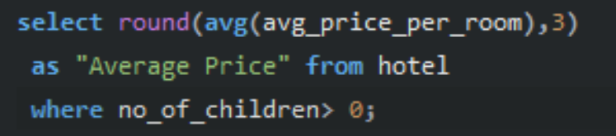
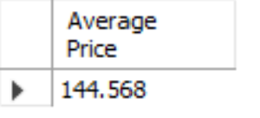
Problem Statement 3:
Which meal plan is the most popular among guests?
SQL Query:
Query Result:

Slide 7
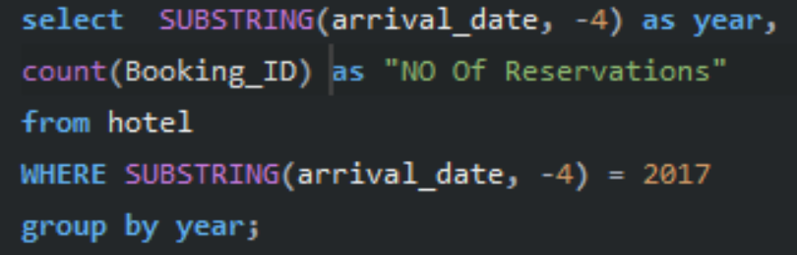
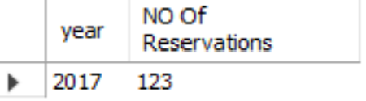
Problem Statement 04:
How many reservations were made for the year 20XX (replace XX with the desired year)?
SQL Query:
Query Result:

Slide 8
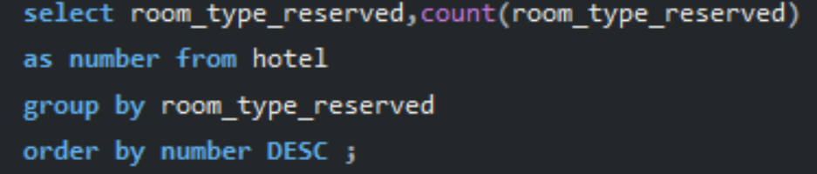
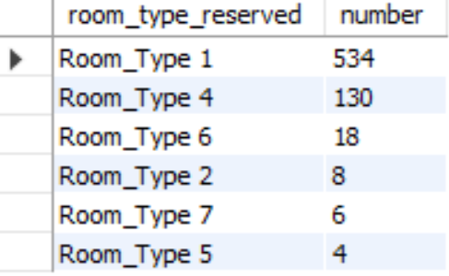
Problem Statement 05:
What is the most commonly booked room type?
SQL Query:
Query Result:

Slide 9
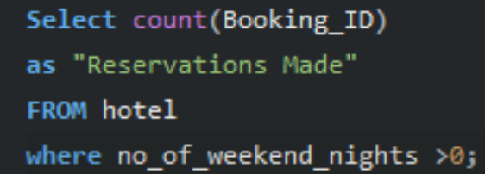
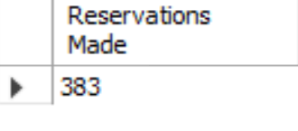
Problem Statement 06:
How many reservations fall on a weekend (no_of_weekend_nights > 0)?
SQL Query:
Query Result:

Slide 10
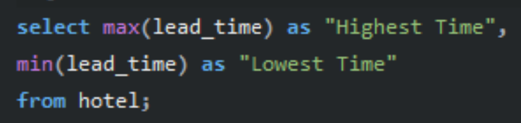
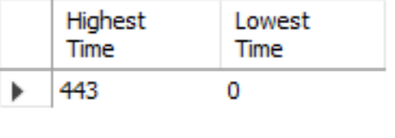
Problem Statement 07:
What is the highest and lowest lead time for reservations?
SQL Query:
Query Result:

Slide 11
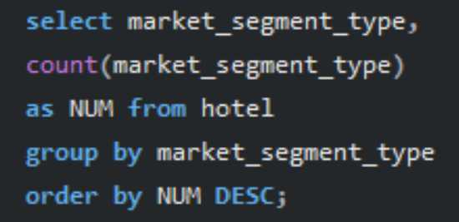
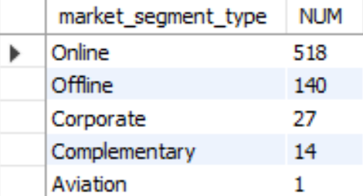
Problem Statement 08:
What is the most common market segment type for reservations?
SQL Query:
Query Result:

Slide 12
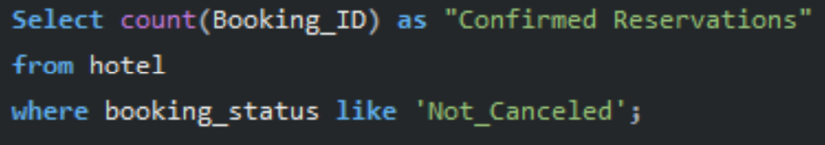
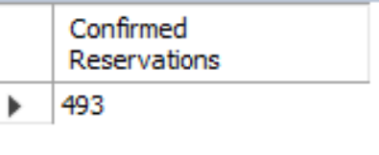
Problem Statement 09:
How many reservations have a booking status of "Confirmed"?
SQL Query:
Query Result:

Slide 13
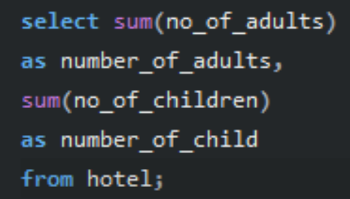
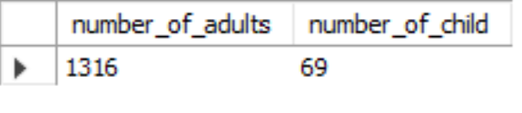
Problem Statement 10:
What is the total number of adults and children across all reservations?
SQL Query:
Query Result:

Slide 14
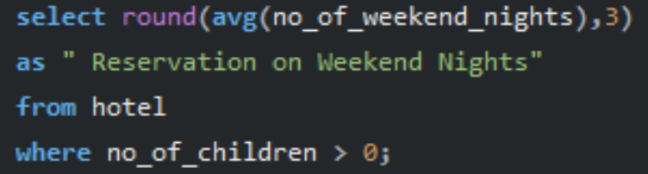
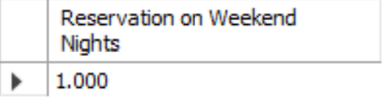
Problem Statement 11:
What is the average number of weekend nights for reservations involving children?
SQL Query:
Query Result:

Slide 15
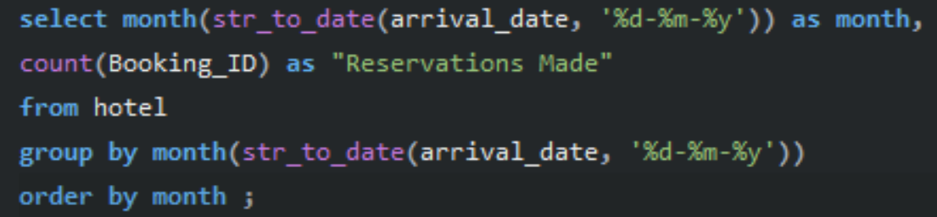
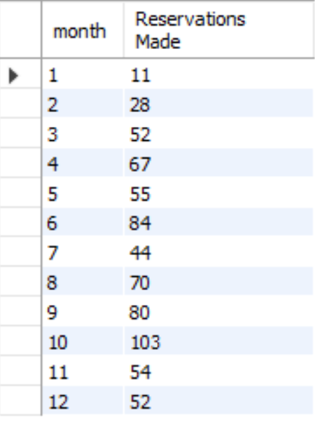
Problem Statement 12:
How many reservations were made in each month of the year?
SQL Query:
Query Result:

Slide 16
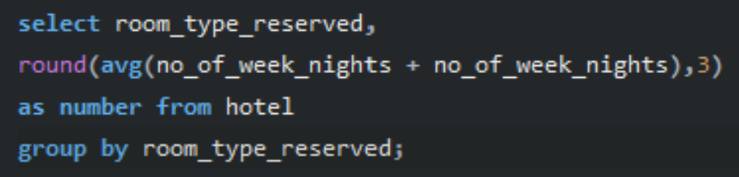
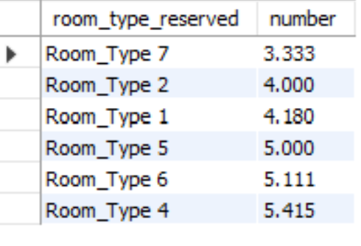
Problem Statement 13:
What is the average number of nights (both weekend and weekday) spent by guests for each room type?
SQL Query:
Query Result:

Slide 17
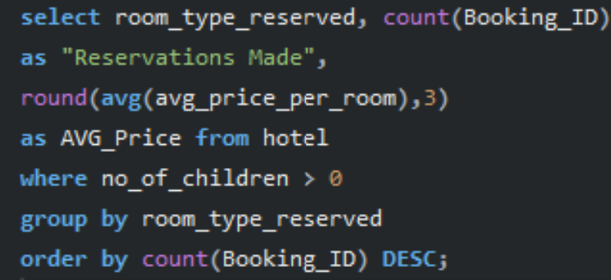
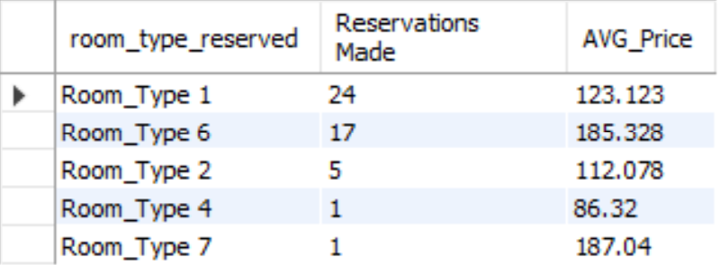
Problem Statement 14:
For reservations involving children, what is the most common room type, and what is the average
price for that room type?
SQL Query:
Query Result:

Slide 18
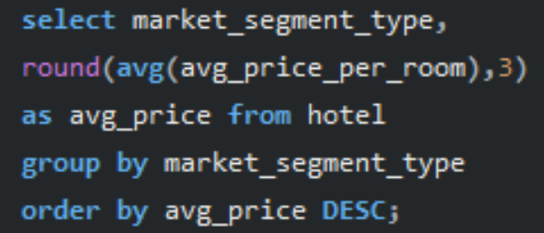
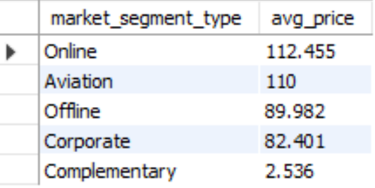
Problem Statement 15:
Find the market segment type that generates the highest average price per room.
SQL Query:
Query Result:

Slide 19
Conclusion:
The hotel reservation analysis revealed key insights: the most popular meal plan and room type, significant weekend bookings, and varied lead times. Families prefer certain room types and price ranges, and the highest average price per room comes from a specific market segment. These findings can guide the hotel in optimizing offerings, marketing strategies, and improving guest experiences to increase occupancy and revenue.

Slide 20
Thank You!
Hrishin Debnath

